Slide 1
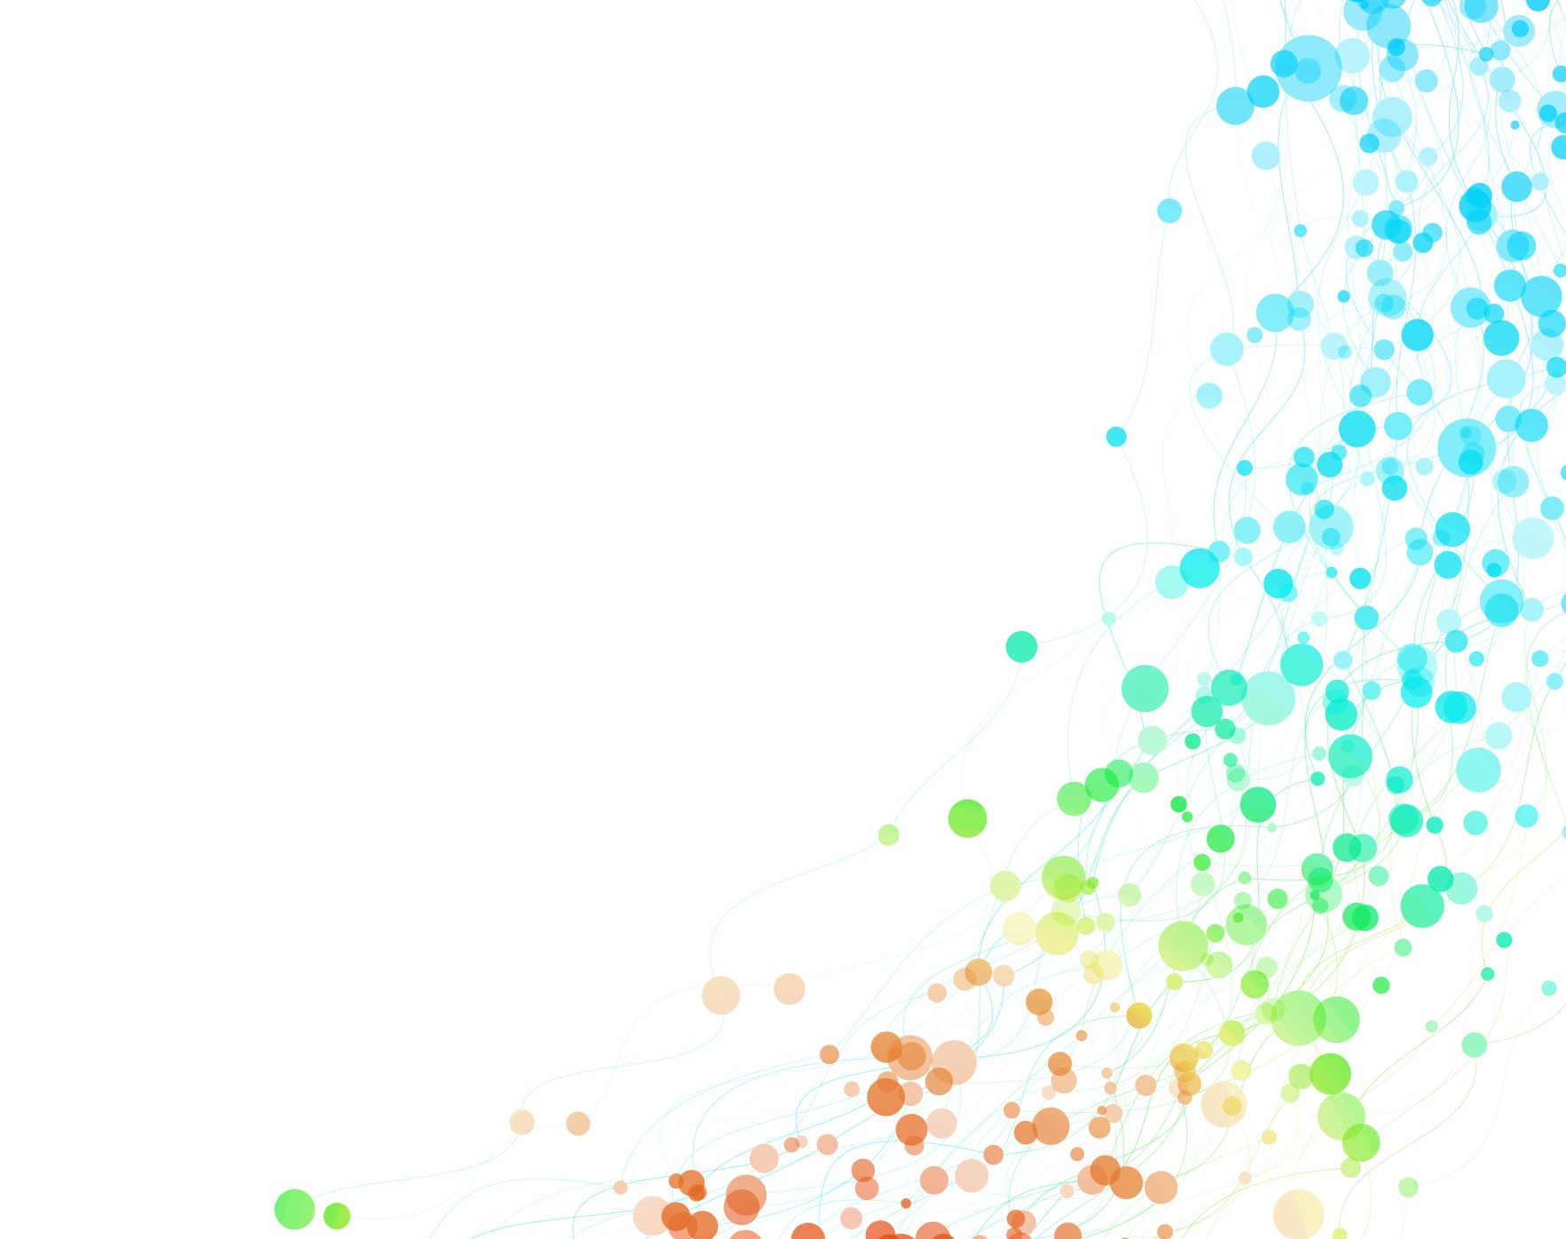
DSA - SELF PACED 8 WEEK SUMMER TRAINING BY GEEKS FOR GEEKS
SUBMITTED BY
Name - Priyanshu Ranjan Registration no. :- 12016486

Slide 2
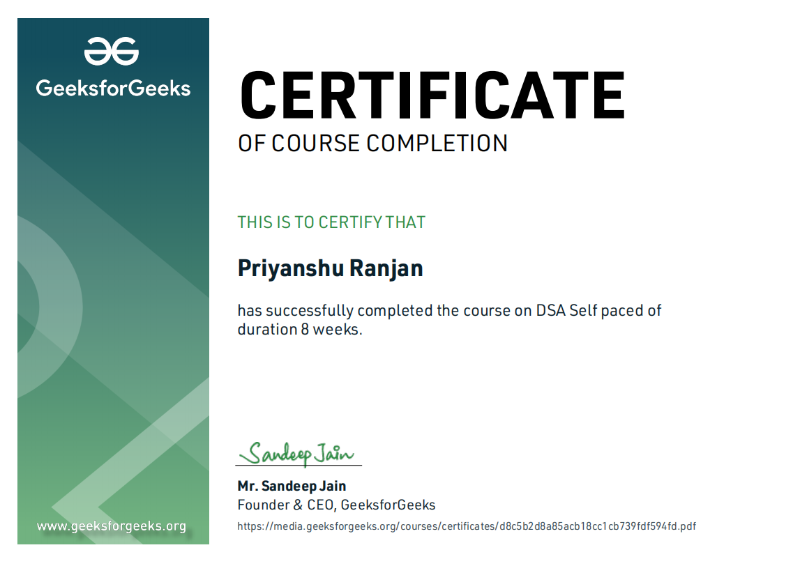
My CERTIFICATE

Slide 3

About Summer Training :
I followed a structured methodology for my 8 Weeks Summer training Program by Geeks for Geeks DSA Self-Paced course .
Which starts from Basic data structures like Arrays, Strings and recursion to the implementation of hard algorithms like Dynamic programming, Segment trees and Backtracking.
I learned algorithmic techniques for solving various problems with full flexibility of time.
And at the end I prepared a Mini Project SNAKE GAME using DSA ( Arrays Data Structure ) , Canvas API for UI design, OOPs to build Snake and game functions , Maths logics used for randomly generating apple and increasing score.

Slide 4
Organisation Information:
With the idea of imparting programming knowledge, Mr. Sandeep Jain, an IIT Roorkee alumnus started a dream, GeeksforGeeks. Whether programming excites you or you feel stifled, wondering how to prepare for interview questions or how to ace data structures and algorithms, GeeksforGeeks is a one-stop solution.
With every tick of time, they are adding arrows in our quiver. From articles on various computer science subjects to programming problems for practice, from basic to premium courses, from technologies to entrance examinations, they have been building ample content with superior quality.
In a short span, they have built a community of 1 Million+ Geeks around the world, 20,000+ Contributors and 500+ Campus Ambassadors in various colleges across the nation. Their success stories include a lot of students who benefitted in their placements and landed jobs at tech giants. Their vision is to build a gigantic network of geeks and there are only a fraction of it yet.

Slide 5
Why this course
This course is a complete package that helped me to learn Data Structures and Algorithms from basic to an advanced level. The course curriculum has been divided into 8 weeks where one can practice questions & attempt the assessment tests according to his own pace.
The course offers me a wealth of programming challenges that will help me to prepare for interviews to all the companies.
Data structures and algorithms (DSA) goes through solutions to standard problems in detail and gives an insight into how efficient it is to use each one of them. It also teaches you the science of evaluating the efficiency of an algorithm. This enables you to choose the best of various choices.

Slide 6
What is DSA?
A data structure is a storage that is used to store and organize data. It is a way of arranging data on a computer so that it can be accessed and updated efficiently.

Slide 7

Why DSA is important :
Data structures and algorithms are an essential part of computer science because they help us to store, process, and analyze large amounts of data.
Without these tools, it would be practically impossible to collect, process, and analyze all the data that is generated by computers around the world. In data structures, we learn how to organize data using various techniques, such as arrays and linked lists. In algorithms, we study the various ways that computers can be programmed to solve problems.

Slide 8
Technology Learnt :
Learn Data Structures and Algorithms from basic to an advanced level
Learn Topic-wise implementation of different Data Structures & Algorithms as follows
Bit Magic
Recursion
Space Complexity
Arrays and Strings
Searching and Sorting
Hashing
Linked List
Stack, Queues and Deque
Tree
Binary Search Tree
Heap
Graphs
Tree
Segment Tree

Slide 9
Project Description : I have made a snake game with help of HTML, CSS, JS and CANVAS for UI design by using data structure and algorithm. I used array data structure to build snake and game function.
What is an Array?
An array is a collection of items of same data type stored at contiguous memory locations.
How it works ? I made blue box line as snake which will be moving on the green board by the arrow key we can change the snake direction and there is an apple which snake have to eat to gain the high score which will be counted at the left top corner and if it touches the red boundary line then the pop up will come as game over. Length of the snake will also increase as much as the snake eat the apple.
How iteration and game loop goes? The init() function is called then called createsnake() function which creates a direction of (x,y) coordinate i.e [(4,0), (3,0), (2,0), (1,0)]. Then we call gameloop() function for n times.
For adding the movement I removed the lost rectangle of snake and add it in front of snake head I did this using updatesnake() function
Direction of snake based on arrow keys when down arrow is pressed then last rectangle is removed and goes below first rectangle. Similarly, I do for left , right and up also.

Slide 10
Used To Create Project
1. Canvas is used for creating like a board to draw on it. [ canvas = document.getElementById('mycanvas’) ]
2. Pen is used for drawing on canvas [ pen = canvas.getContext('2d’) ] – creates a pen which is drawn in 2D.
3. Inserting image- [food_img = new Image()
food_img.src = ""]- creates an object inbuilt class image
4. Getting food randomly [var foodX = Math.round( Math.random()*(W-cell_size) /cell_size);] – Math.round is the round number, Math.random() is for generating the number from 0-1 and w-cell_size is used so that value generates one of the cells starting coordinate.
5. Key pressed detect - function keyPressed(e){ //e is the object
If (e.key == 'ArrowRight’){ //e.key is used to stored which key was pressed
snake.direction = 'right’;}}
document.addEventListener('keydown', keyPressed); //keydown detects which key is pressed, key pressed is used as if key pressed then function is called.

Slide 11
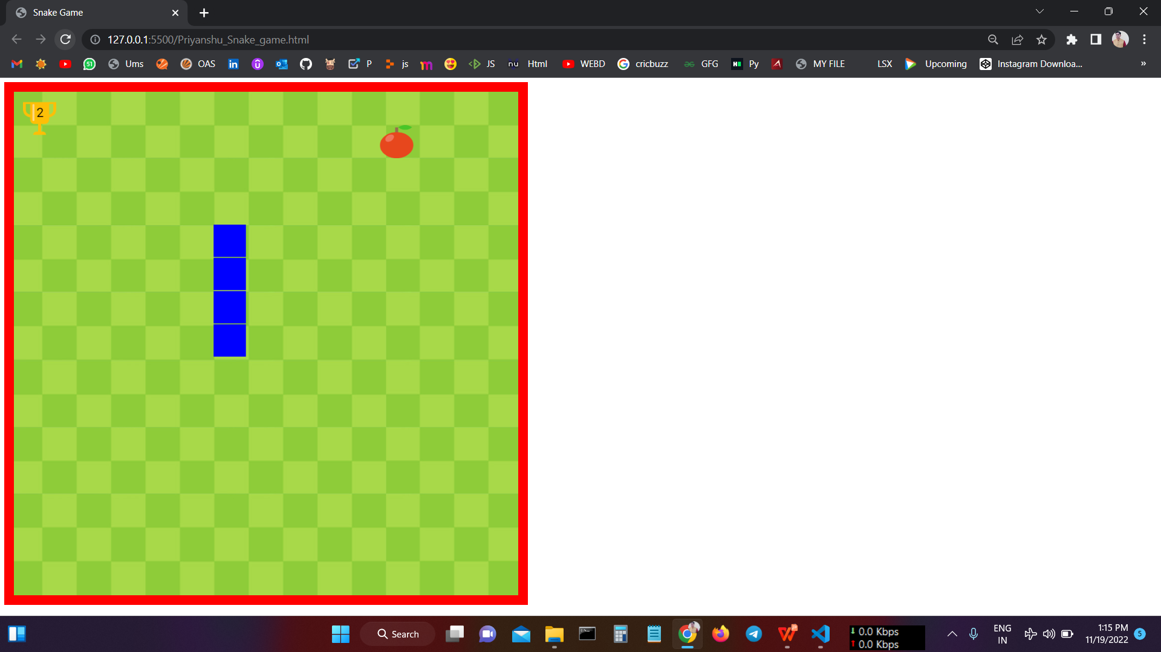
Output

Slide 12
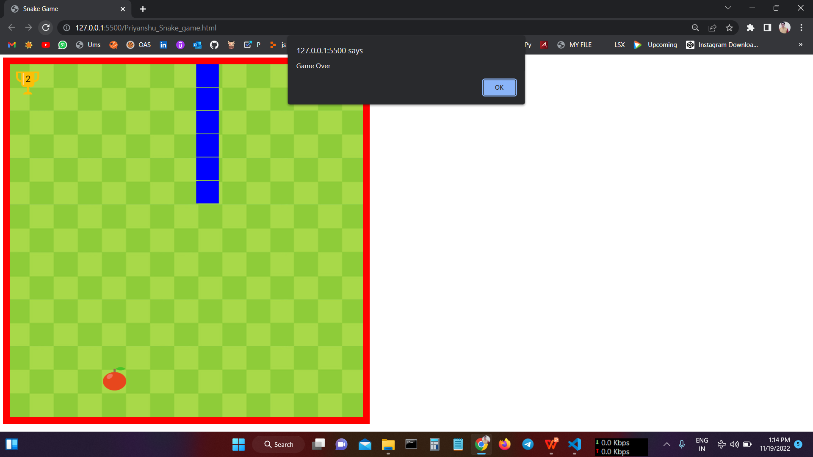

Slide 13


